Slide 1

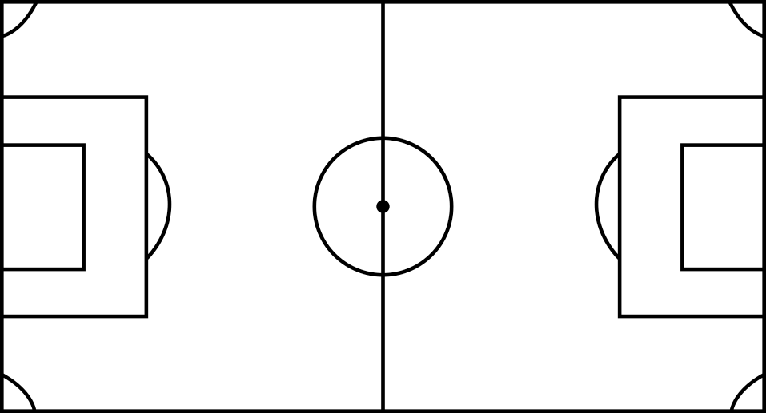

TEAM
LOCALIZATION
SCOUTER
DOB
FOOTED
TEAM
LOCALIZATION
SCOUTER
DOB
FOOTED
TEAM
LOCALIZATION
SCOUTER
DOB
FOOTED

Slide 2
PLAYER LEVEL
Rating | Level
0.5 | Below Academy Level
1 | Academy Level
1.5 | Academy Standout
2 | National Team Depth Chart
2.5 | National Team Level
3 | National Team Core Player
3.5 | National Team Standout
4 | International Level
4.5 | International Standout
5 | World Class
OPPONENT LEVEL
A | Higher MLS DA Level
B | MLS DA Level
C | Lower MLS DA Level
LOCALIZATION
1 | Inside 50 milles around stadium'
2 | Inside Homegrown zones
3 | Outside Homegrown zones

